Slide 1
MBAN 6400 S5 – Logistics Regression and Linear Discriminant Analysis (LDA) Hemant Sangwan

Slide 2
Agenda – Supervised ML (Classification)
Fundamentals of logistic regression
Logistic regression – Basic and Advanced
Strengths and limitations of logistic regression
Logistic regression as choice models – Database Marketing and Individual Level Targeting
Recency, Frequency and Monetary (RFM) value for targeted marketing
Understand scoring customers for individual targeting
Regression Model
Binary Logit
Expected profit
Linear Discriminant Analysis (LDA)

Slide 3
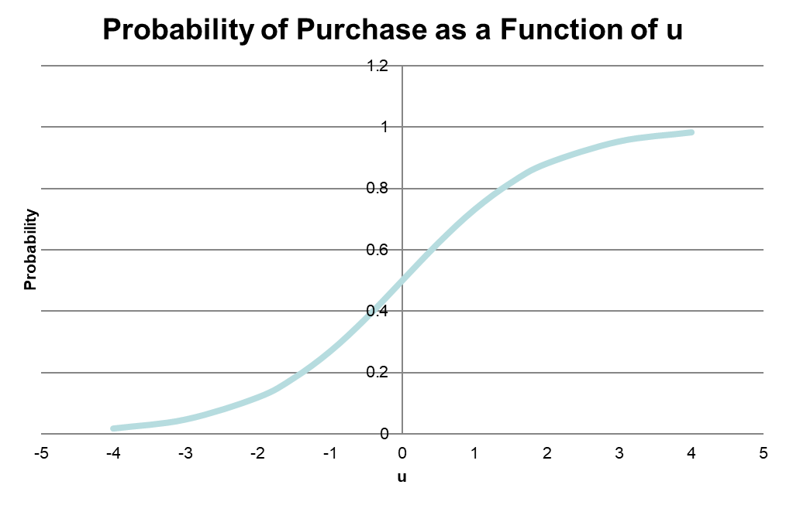
Logistic Regression
Estimate probability that an observation/case will fall into one of the groups based on a given set of IVs
Example: Based on specific values of attributes of a car (e.g., price, brand, safety rating, mileage, etc.), what is the probability of you purchasing it?
Binary Logit
Y is coded as (purchase =1 , not purchase =0)
Probability of consumer i buying the product is
U = utility of purchasing the product
U=0 utility of not purchasing the product

Slide 4
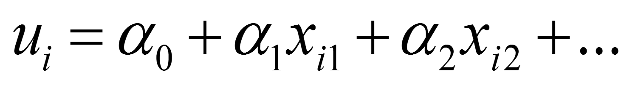
Binary Logistic Regression
u is measured as a linear function of observable characteristics Xs
Xs = price, brand, demographics, etc.
α: measures influence of x on utility
Influence of α on purchase probability:
positive: increase probability
negative: decrease probability
Algorithm or software will find the α coefficients that best “fit” the data in the sense they maximize the probability of observed choices
$d_{i}=\left\{\begin{aligned}1 if individual i buys \\ 0 otherwise\end{aligned}\right. \hat{α}$ = argmax $\sum_{i=1}^{N}{\left(\log\left(P\left(buy | α\right)\right)d_{i}+\log\left(1−P\left(buy | α\right)\right){(1−d}_{i})\right)}$

Slide 5
Maximum Likelihood Estimation (MLE) – Conceptual Idea
The event (or data) you observed is one of the many possibilities which could have happened
So perhaps the event which actually occurred has the highest probability of happening among the many possibilities
So find the values of parameters of the model (or data generating process DGP or simply distribution parameters) which maximize the probability of event actually observed….hence the name maximum likelihood estimation
Example: product choice (e.g., buying car or no car, etc.)

Slide 6
Linear Regression vs Logistics Regression
Can we use linear regression (LR) when DV y is categorical (y=0 if no purchase, y=1 if purchase, etc.?
Technical answer: predicted values might be outside (0,1) or (1,n)
Intuitive answers
Categorical variables are not on interval scale, which is a minimum requirement for linear regression to work? Why?
What are key assumptions and restrictions imposed on data structure in linear regression which prevents using categorical DV?

Slide 7
Choice Models

Slide 8
Choice Models – Basic Idea
As the same suggests, choice models try to model our choice behaviour
When consumers make choices (e.g. purchase, voting, other behavioural choice – healthy lifestyle, using public transport, etc.), they…
Focus on specific attributes / features of that choice (e.g., price, brand, convenience, favourable perception, etc.)
Assign different weights to different attributes in their final decision, i.e., not all attributes/features are valued equally
Choice models, based on observed choices, try to separate and measure the influence of each attribute on the final choice

Slide 9
Choice Models – Activity
Select a category familiar to you
Think of three attributes that are important for that category (exclude price, history, reputation and brand name)
Give importance weights to each attribute such that total sum of weights must equal 10, no zero or negative values
Note the difference in weights assigned to attributes. Compare your weights to those assigned by other customers

Slide 10
Choice Models – How modeling works?
Assumptions and Setup
There are N customers, n=1,2,3,….N. And J products available j=1,2,3,….J
A customer, i, chooses a single product j which maximizes his/her utility
U_{ij} = V_{ij} + e_{ij} = max ( V_{i1} + e_{i1} , V_{i2} + e_{i2} , V_{i3} + e_{i3} ,….., V_{iJ} + e_{iJ} )
where:
U_{ij} =Utility that customer i has for product j
V_{ij} =Deterministic component of utility that is a function of product attributes (emotional and functional. V_{ij} is observed to researcher
e_{ij} =An error term that reflects the non-deterministic component of utility (observed to consumer, but not researcher)

Slide 11
Choice Models – Assumptions on Errors Terms
If e_{ij} ~ N (0, sigma) then it is called Probit model
Probit models are difficult to estimate as there is no closed form solutions, i.e., estimation only by simulation or numerically
If e_{ij} ~ Type -1 extreme value (i.e., logit errors), then it is called Logit model. Logit models have closed form solutions
e_{ij} ~ independently, and identically distributed (across products, individuals, time), iid
e_{ij} ~ independent of product attributes and observed data (X’s, demographics, etc.)
$$F\left(ε\right)=e^{{−e}^{−ε}}$$

Slide 12
Probability of Choice in Logit Models
If e_{ij} ~ iid, Type -1 extreme value (i.e., logit errors), and customers maximize their utility then
P_{ij} =probability that customer i chooses product j
V_{ij} =deterministic component of utility
P_{ij} increases with V_{ij}

Slide 13
Deterministic component of utility
i =an index to represent customers, j is an index to represent products, and k is an index to represent attributes
x_{ijk} =i’s perception of attribute k for product j (observed to researcher)
α_{k} =estimated coefficient to represent the impact of x_{ijk} on the utility for attribute k of product j for customer I
α_{k} positive: increase choice probability
α_{k} negative: decrease choice probability

Slide 14
Estimating Logit Choice Models
Inputs: observed choice for customer i, product attributes Xs
Processing: Model estimated using Maximum likelihood (MLE) or other simulation methods
Outputs of estimation
Estimated values and standard errors of α_{k}
Estimated impact of α_{k} → P_{ij}
Estimated choice probability P_{ij} or marginal impact of X on P

Slide 15
Marginal Impact of Attributes on Choice
Own effect:
Logit Elasticity: % change in choice probability P with a % change in X
Own:
Cross
Index l does not entre in cross elasticity. How do you interpret it?
Hint: if there are three products, l1, l2, l3 with choice probability (75%, 10%, 15%). If you drop the price of l1, and its choice probability goes up to 80%. What would be the change in choice probability of l2 and l3?
5%, 10%

Slide 16
Estimating Logit Models – Other considerations
Normalization
Two customers Brenda and David will have the same choice probability for each product, even if their utility values are different
Solution:
If we have alternative-specific constants, we must normalize one to zero
Add an outside good, with utility zero. V_{i0}=0
$$P_{ij}=\frac{e^{V}}{\sum_{l}{e^{V_{l}}}}=\frac{e^{a+V}}{\sum_{l}{e^{{a+V}_{l}}}}$$
 | Brenda | David
Labatt’s | U_{BL} = 1 | U_{DL} = 2
Molson | U_{BM} = 3 | U_{DM} = 4

Slide 17
Limitations of Logit Models
Independence of Irrelevant Alternatives (IIA)
Implies proportional substitution
No persistent unobserved taste variation/heterogeneity
No unobserved preferences for brands (some like Coke, some like Pepsi)
No unobserved heterogeneity in price sensitivities
Random coefficients model can handle unobserved heterogeneity
No serially correlated unobservable
Similar to the above point – cannot have tastes be persistent (but not perfectly correlated) over time
IIA
$$\frac{P_{il}}{P_{im}}=\frac{\frac{e^{V(l)}}{\sum_{n}{e^{V_{in}}}}}{\frac{e^{V(m)}}{\sum_{n}{e^{V_{in}}}}}=\frac{e^{V(l)}}{e^{V(m)}}$$

Slide 18
Limitations of Logit Models- IIA
Independence of Irrelevant Alternatives (IIA) implies proportional substitution
Suppose there are two transportation options: red bus and car
These are chosen with probability ½ each; same utilities
Now suppose that a transit authority wants to introduce a blue bus
Riders perceive blue bus to be the same as red bus
We expect:
This is because the car riders see no change in their choice scenarios. It is still a choice between car and bus for them. Bus riders splits between red and blue bus because they both are exactly the same for riding purpose. However, IIA implies

Slide 19
Limitations of Logit Models- IIA
Independence of Irrelevant Alternatives (IIA) implies cross elasticity does not depend on own index. For example, change in price of bus ridership will affect car ridership equally, irrespective of attributes/features associated with the car
Suppose we change an attribute of product j ≠ l, m. Then choice probability before (denoted 0) and after the change (denoted 1)
or
Choice probability of l and m, after the change in price of j are proportional to their respective choice probability before the change in the price of j
Intuition: if price of product j goes down, it draws an equal proportion of consumers from all other products.

Slide 20
Applications of choice / logit models
Optimal pricing (demand estimates)
Estimates of cross-elasticities: own product cannibalization, substitution to competitor products
Estimates of cannibalization from new product introduction (but be careful of IIA!)
If demographics are used, helps to understand characteristics of types of consumers. For example, who is brand loyal, price sensitive, etc.

Slide 21
Database Marketing and Individual Level Targeting

Slide 22
Agenda – Database Marketing and Individual Level Targeting
Understand why marketers use Recency, Frequency and Monetary (RFM) value for targeted marketing
Understand scoring customers for individual targeting
Regression Model
Binary Logit
Expected profit
Understand the use of validation data

Slide 23
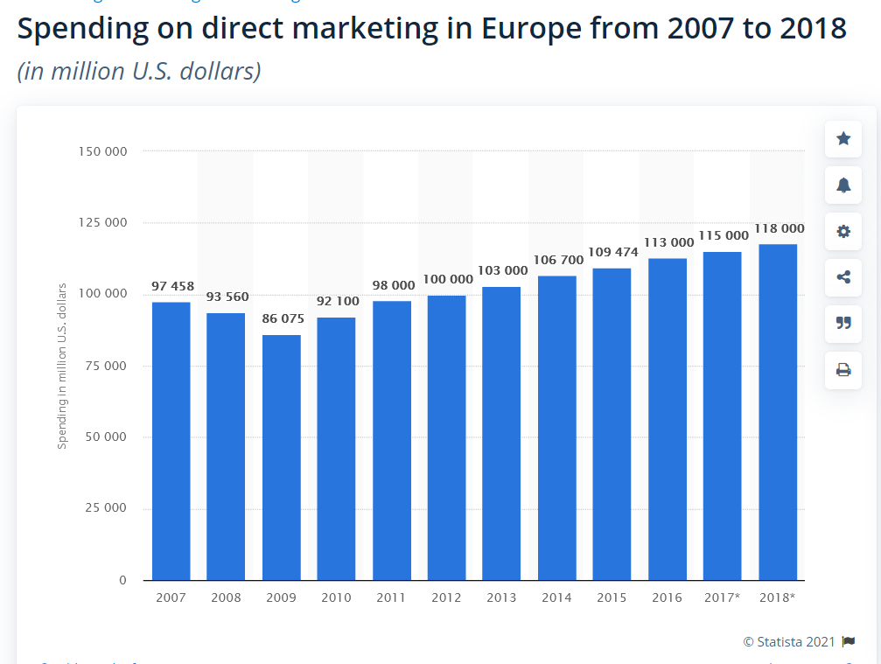
Importance of Database Marketing
Direct mail has lowest cost per lead/order of $51.40 ($52.58 for pay-per-click, $60.50 for print, $190.49 for telemarketing, and $55.24 for email)
“Direct mail is not cool, but it works, which is why it came back.”

Slide 24
Database Marketing - Activity
Suppose you run the mailing operation for a major catalog firm. You have designed a new seasonal “Winter Catalog”. You estimate the cost of mailing (including catalog and mailing cost) is $3. Currently you have a house list of approximately 5.6 million customers with past purchase records.
How would you create a “mailing list” for the “Winter Catalog” from your house list?
House List: List of your customers who have purchased at least once
Rental list: Mailing list acquired externally, for customer acquisition only
Direct mail response rate 3.7% for a house list and 1.0% for a prospect (rental) list

Slide 25
Recency, Frequency, and Money (RFM) Model

Slide 26
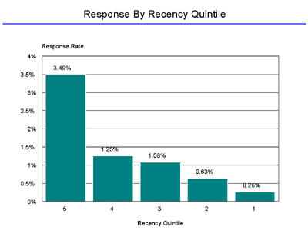
Recency and its importance
Recency
Time since last purchase
Example: A direct marketer with a house list of 2.1 million names conducted test mailing of a new offer to 30,000 names. 402 responded. 1.33% response rate
Sort data by Recency, from smallest to largest, in quintile
5 groups, 30,000/5 = 6,000 names each group
Compute average response rate per quintile group

Slide 27
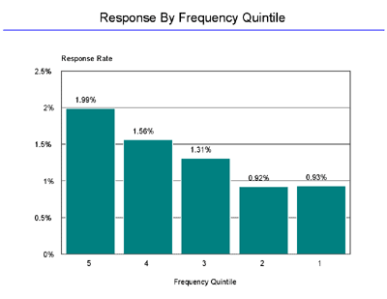
Frequency and its importance
Frequency
Number of purchases in a given time period (e.g., last 2 years)
Sort data by Frequency, from largest to smallest, in quintile
5 groups, 30,000/5 = 6,000 each group
Compute average response rate per quintile group

Slide 28
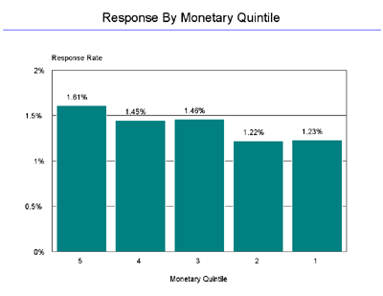
Amount and its importance
Money (or amount)
Average amount per purchase
Sort data by “amount”, from largest to smallest, in quintile
5 groups, 30,000/5 = 6,000 each group
Compute average response rate per quintile group

Slide 29
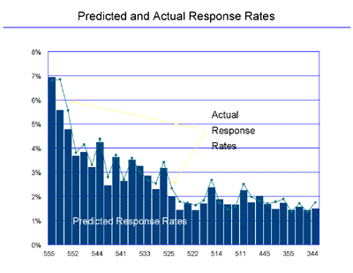
RFM cells – combining R, F, and M (5 x 5 x 5 = 125)
If using Quintile method,
Rank order 5×5×5 = 125 cells by response rate
Select cells with “high response rates”
Breakeven response rate: Response Rate × Unit Profit Margin = Unit Mailing Cost
Quick profit increase “without statistics”!
RFM Cells | Response Rate
555 | 8.33%
554 | 6.66%
553 | 5.42%
552 | 4.17%
551 | 4.58%
545 | 3.75%
544 | 5.00%
543 | 2.50%
542 | 4.17%
541 | 2.92%
… | …
111 | 0.01%

Slide 30
Model Based Individual Targeting

Slide 31
Model Based Individual Targeting – Basic Method
Use a sample of customers that received mails
Estimate a model relating response (purchase) to individual-characteristics (RFM, demographics, etc.)
Use model estimates to compute an individual “score”: predicted purchase probability
Ask “what if questions”: what if I mail to top 10% (20%, 30%, 40%, 50%, …) customers based on score? Compute response rate.
Compute “lift” – increase of response rate
Compute profit-maximizing percentage of customers to target

Slide 32
Model Based Individual Targeting
We will use two models to compute scores: regression and binary logit
An alternative (and often-used) approach is RFM scoring:
Assign each individual a certain number of points based on RFM values
Point assignment can come from an RFM scoring table (example on following slide)
This approach often works well in practice, but it can be hard to come up with a scoring rule

Slide 33
Model Based Individual Targeting
Recency
0-2: 25 points
3-6: 20 points
7-9: 15 points
….so on
Frequency
>30: 25 points
21-30: 20 points
16-20: 15 points
….so on
Amount
>400: 25 points
301-400: 20 points
….so on
Create Individual RFM Score: R score + F score + M score
R | Months from last purchase | ≥13 | 10-12 | 7-9 | 3-6 | 0-2
 | Score | 5pts | 10 | 15 | 20 | 25
F | Frequency | > 30 | 21-30 | 16-20 | 11-15 | 0-10
 | Score | 25pts | 20 | 15 | 10 | 5
M | Amount purchased | > 400 | 301-400 | 201-300 | 101- 200 | ≤ 100
 | Score | 50 | 45 | 30 | 15 | 10

Slide 34
Model Based Individual Targeting – Regression Approach
Estimate regression model for response probability
Probability of Response = α+β1*Gender + β2*Amount+β3*Frequency+β4*Recency+β5*P-child
+β6*P-Youth +β7*P-cook + β8*P-DIY + β9*P_art + ε
Interpret results: statistical and economic significances
Use estimation equation to compute “score” (fitted values)
Predicted choice probabilities from the regression model need not necessarily lie between 0 and 1, although most of the probabilities will fall in that range.

Slide 35
Model Based Individual Targeting – Binary Logit
Model of decision to buy/not buy (0= not purchase, 1= purchase)
Probability of consumer i buying product
u = utility of buying product for consumer i, utility of not buying = 0
Estimate binary logit model
Utility of buying U = α+β1*Gender + β2*Amount+β3*Frequency+β4*Recency+β5*P-child
+β6*P-Youth +β7*P-cook + β8*P-DIY + β9*P_art + ε
Compute fitted choice probability =
Note: unlike regression, fitted values are between 0 and 1
But, predictions will likely be similar

Slide 36
Validation of Models
Statistical validity
Estimation (calibration) sample: a sample for estimating coefficients of regression (or logit) model
Predictive validity
Holdout sample: a sample to examine predictive validity
Why have two samples?
Our model will always provide a better prediction on the sample used for estimation than a new, randomly drawn sample

Slide 37
Decile Classification
Standard Assessment Method
Apply the results of approach and calculate the “score” of each individual (calibration versus test sample)
Order the customers based on “score” from the highest to the lowest
Divide into deciles
Calculate/graph hit rate and profit
Customer 1 Score 1.00
Customer 2 Score 0.99
….
Customer 230 Score 0.92
Customer 2300 Score 0.00
Decile 1
…..
…..
Decile 10

Slide 38
Decile Classification and Hit Rate
Customer 1 Score 1.00
Customer 2 Score 0.99
….
Customer 230 Score 0.92
Customer 2300 Score 0.00
Decile 1
…..
…..
Decile 10

Slide 39
Customer Targeting – Summary of Steps
Step 1: Create database of customer responses (choices) based either on test mailing to a sample of prospects/customers, or historical data of past customer purchases
Step 2: Use models such as regression, or RFM to assess the impact of independent variables (drivers) of customer response
Step 3: Score each customer/prospect based on the drivers identified in Step 2 - the higher the score, the more likely is the predicted response
Step 4: Classify customers into deciles (or smaller groupings) based on their scores
Step 5: Based on profitability analyses, determine the top deciles to which a marketing action (e.g., mailing of brochure) will be targeted

Slide 40
Example – Customer Scoring and Profitability
A B C D Customer Score Average Customer Deciles (Purchase Purchase Expected $ Probability) Volume Margin = A x B x C
1 30% $31.00 0.70 6.51 2 2% $143.00 0.60 1.72 3 10% $54.00 0.67 3.62 4 5% $88.00 0.62 2.73 5 60% $20.00 0.58 6.96 6 22% $60.00 0.47 6.20 7 11% $77.00 0.38 3.22 8 13% $39.00 0.66 3.35 9 1% $184.00 0.56 1.03 10 4% $72.00 0.65 1.87

Slide 41
Example – Decile Classification
If the marketing cost to reach a customer is $3, at what decile will you stop your targeting effort?
How is this targeting plan different from one based on average purchases of customers ($3.72) – all or nothing?
Decile Customer(s) $
1 5 6.96 2 1 6.51 3 6 6.20 4 3 3.62
5 8 3.35 6 7 3.22
7 4 2.73
8 10 1.87
9 2 1.72
10 9 1.03

Slide 42
Example – Lift Charts and Choose Model for Implementation

Slide 43
Key Takeaways
Score customers for more precise targeting
Methods
Regression model: what’s the right specification?
Binary Logit model
RFM method/RFM score
Validation and lift charts

Slide 44
Linear Discriminant Analysis (LDA)

Slide 45
Linear Discriminant Analysis – Hide and Seek with CRA
“The magnitude of this massive avoidance (if not evasion) of taxes in Canada is not yet known by most Canadians. Dennis Howlett, who heads the reputable Canadians for Tax Fairness agency, after long and thorough research, estimates that corporations and the wealthiest Canadians are sending well over $250 billion every year to offshore havens to avoid paying taxes in Canada.”
“The tax on that enormous sum would come to at least $10 billion annually, and potentially to $15 billion or more. If those taxes had been added to Canadian government revenue for the past 10 years, as they should have been, instead of being stashed away in tax havens, they would have immensely increased funding for our social programs. Public health care could have been expanded to include prescription drugs, dental and vision coverage. We could now have free university tuition, free and much improved child care, refurbished infrastructure, and much better treatment of our indigenous peoples.”
Source: Canadian governments' revenue would soar by billions if tax evasions were stopped (Feb 2018) Retrieved from http://rabble.ca/blogs/bloggers/rabblecas-staff-blog/2018/02/canadian-governments-revenue-would-soar-billions-if-tax

Slide 46
Linear Discriminant Analysis – Basic idea (Differentiating factors)
Which factors (e.g., demographic, behavioural, social, contextual) differentiate between those buying luxury cars vs those who do not?
Only demographic variables (e.g. gender, income, etc.), i.e., if you are rich, do you have to spend on luxury items?
What do we look for when we differentiate between two objects/persons/behaviours/products/items, etc.?

Slide 47
Linear Discriminant Analysis – Where it fits?
LDA belongs to machine learning (or multivariate) methods where dependent variable is categorical
Categorical DV variables represent group membership
Defaulter vs non-defaulter
Purchase vs no purchase, etc.
Absence and presence of some event (e.g., employed, unemployed)
A few common techniques, other than LDA, to analyze categorical dependent variable
Cross tabs
Contingency table
Logistic regression
Probit

Slide 48
Linear Discriminant Analysis ML Algorithm – Three objectives
Find a set of independent variables (IVs) which best differentiate between two or more groups
Use identified IVs to compute an index which represents the difference between the groups
Use computed index to classify external observations into one of the groups
Examples
Which set of product performance attributes differentiates between buyers and non-buyers?
Which set of health and profile variables (e.g., height, weight, bone density, etc.) differentiate between male vs female?
Do the debt or equity set of variables differentiate between firms paying dividends or not?

Slide 49
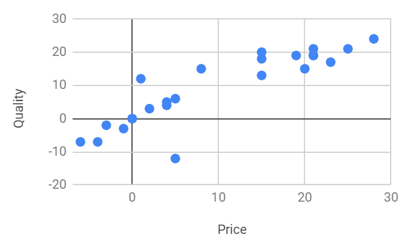
Linear Discriminant Analysis ML Algorithm – Visualization
Z1=w1 price + w2 quantity
Purchasers
Non-purchasers
Cutoff value

Slide 50
Linear Discriminant Analysis ML Algorithm
Find (w1, w2) such that Z1=w1 price + w2 quantity, AND the following conditions are satisfied
𝜆=SSB/SSW is maximum
SSB = sum of square between groups
SSW= sum of square within group
Means of Z in two groups must be as far as possible, i.e., SSB is as large as possible
Values of Z within a group must be as close to each other as possible, i.e., SSW is as small as possible
Function Z1 is also known as Fisher’s linear discriminant function
Do we need both conditions 2 and 3 to be independently satisfied?
What if either 2 or 3, but not both are satisfied?

Slide 51
Linear Discriminant Analysis ML Algorithm (Matrix form)
Find (𝜸1, 𝜸2, ...𝜸p) such that 𝜆=𝜸’B𝜸/𝜸’W𝜸 is maximized, i.e., 𝞉𝜆/𝞉𝜸=0
𝞉𝜆/𝞉𝜸 = 0 → [2(B𝜸)(𝜸’W𝜸)-2(𝜸’B𝜸)W𝜸]/(𝜸’W𝜸)² = 0
|W⁻¹B-𝜆I |w=0, i.e., 𝜆 is eigenvalues of W⁻¹B, and discriminant weights are eigenvectors of W⁻¹B
𝜆 is related to sum of square of discriminant score
(X’𝜸)’(X’𝜸) = 𝜸’XX’𝜸 =𝜸’(B+W)𝜸= 𝜸’B𝜸+𝜸’W𝜸
If there are only 2 groups, i.e., p=2, then
B=[(n1 x n2)/(n1+n2)] (𝛍₁-𝛍₂)(𝛍₁-𝛍₂)’
𝜸=KW⁻¹(𝛍₁-𝛍₂)=K𝜮⁻¹(𝛍₁-𝛍₂)
Discriminant weights are unique up to a multiplicative constant

Slide 52
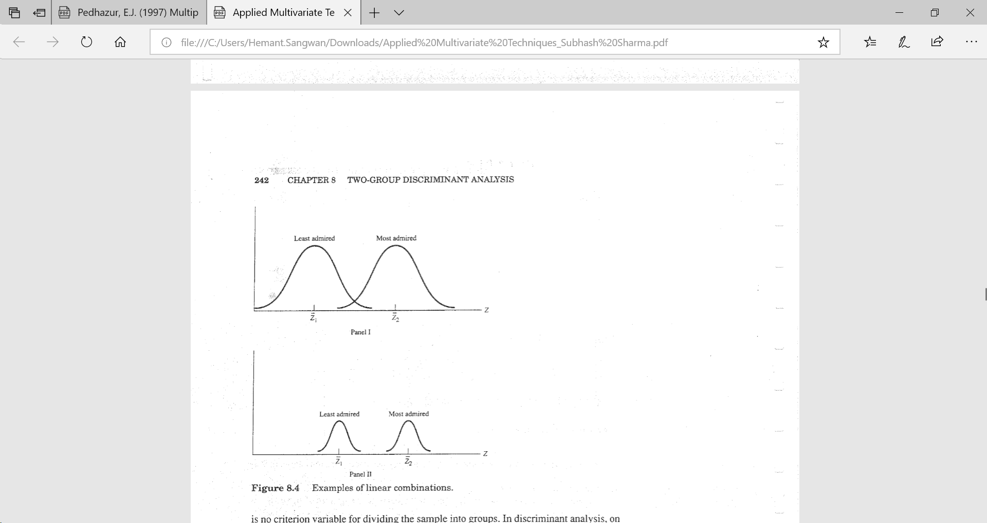
Linear Discriminant Analysis ML Algorithm
Panel 1: between group separation is higher, i.e., z values are farther apart
Panel-II: within group variance is lower, i.e., groups are homogenous wrt Z1 and Z2
Which solution is better?

Slide 53
Linear Discriminant Analysis – Key Assumptions
Data on p-variables come from multivariate normal distribution
Covariance matrices of two groups are equal
What would happen if one or both of the above assumptions are not satisfied?
How would you use LDA if the dependent variable is not categorical, i.e., continuous. For examples, sales in dollars

Slide 54
Linear Discriminant Analysis – Classification methods
Cutoff-value methods
The value of discriminant score that divides discriminant space into 2 regions is called cut-off value
Commonly used cutoff value is c= n₁Z₁+ n₂Z₂)/(n₁+n₂), where Z_{j} is average discriminant score for group j
Classification function method: Assign to the group with largest classification score
Distance method: Assign to the group with the closet distance based on selected distance measure
Classification is based on prior probability using Bayesian approach, e.g. if proportion in the original data is purchaser-40%, non-purchasers-60%, then compute updated proportions using Bayesian approach
Based on classification costs, which are not symmetric in most cases
Financially healthy vs bankrupt
Guilty vs not guilty

Slide 55
Linear Discriminant Analysis vs Logistic Regression
What are similarity and differences between
LDA and Logistic regression
LDA and Linear Regression
LDA and Clustering

Slide 56
Linear Discriminant Analysis
Data: For nine mandible measurements on samples from five different canine groups. Carry out a discriminant function analysis to see how well it is possible to separate the groups using the measurements.
Investigate each canine group separately to see whether logistic regression shows a significant difference between males and females for the measurements. Note that in view of the small sample sizes available for each group, it is unreasonable to expect to fit a logistic function involving all nine variables with good estimates of parameters. Therefore, consideration should be given to fitting functions using only a subset of the variables
X1 = length of mandible
X2 = breadth of mandible below 1st molar
X3 = breadth of articular condyle
X4 = height of mandible below first molar
X5 length of first molar
X6 = breadth of first molar
X7 = length of first to third molar inclusive (first to second for cuon)
X8 = length from first to fourth premolar inclusive,
X9 = breadth of lower canine, all measured in millimeters
The Sex code is 1 for male, 2 for female, and 0 for unknown

Slide 57
R-code
# Linear discriminant analysis, using lda, with allocations to groups
skulls <- read.csv("Egyptian skulls.csv",header=TRUE)
attach(skulls)
# lda is a function of the package MASS
# Before running library(MASS) make sure you have installed the package
library(MASS)
skulls.lda <- lda(Period ~ ., data=skulls)
skulls.lda
# One of the objects in skulls.lda is skulls.lda$scaling, the coefficients of linear discriminants, a #matrix which transforms observations to discriminant # functions, normalized so that within groups covariance matrix is spherical
# (similar to equations 8.2, but with a different scaling)
skulls.lda$scaling
# Producing the allocation table (Table 8.4)
alloc.tab <- table(Period,predict(skulls.lda)$class)
alloc.tab[c(2,3,1,4,5),c(2,3,1,4,5)]
detach(skulls)
# End of script

Slide 58
Recommended Readings
Logistic Regression. Retrieved from https://christophm.github.io/interpretable-ml-book/logistic.html
Logistic Regression. Retrieved from https://towardsdatascience.com/logistic-regression-detailed-overview-46c4da4303bc
Linear Discriminant Analysis https://sebastianraschka.com/Articles/2014_python_lda.html
Linear Discriminant Analysis, Explained. Retrieved from https://towardsdatascience.com/linear-discriminant-analysis-explained-f88be6c1e00b

Slide 59
Next Session

